Slide 1
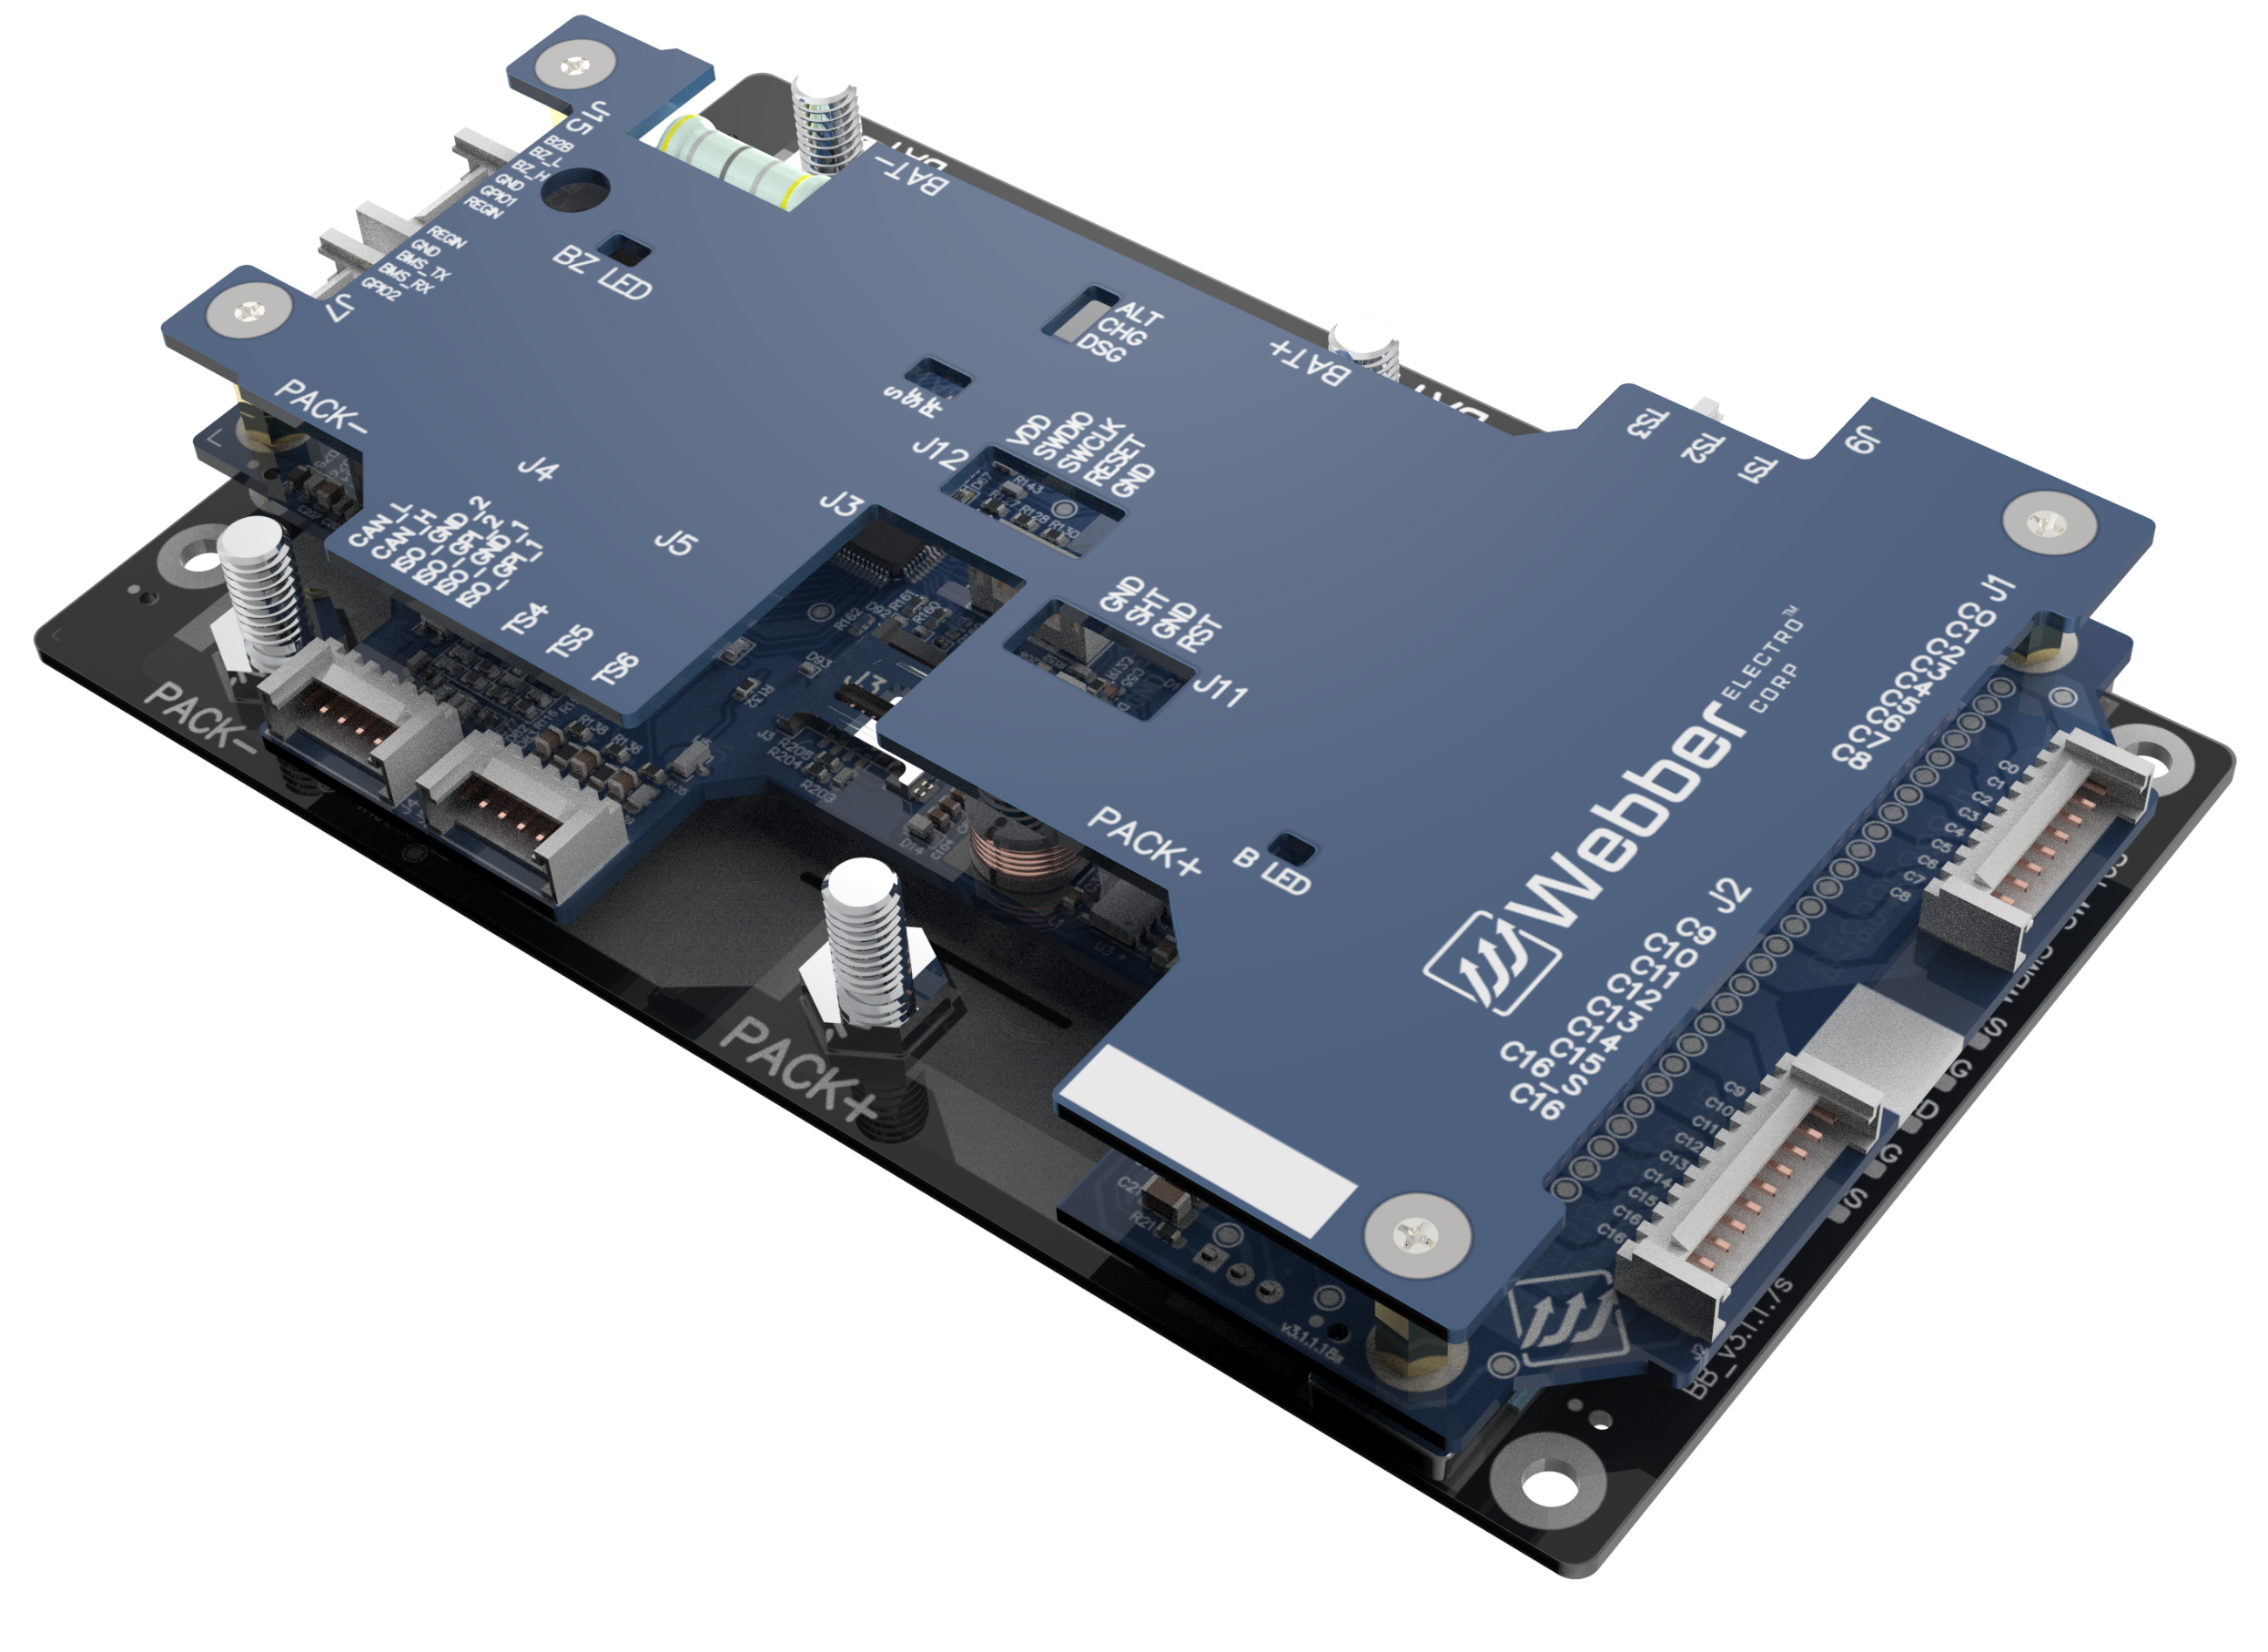
WBMS-SW 16S 60/80A
Smart BMS Manages Lithium Ion Batteries
with Precision and Speed
Specification Sheet v3.0

Slide 2
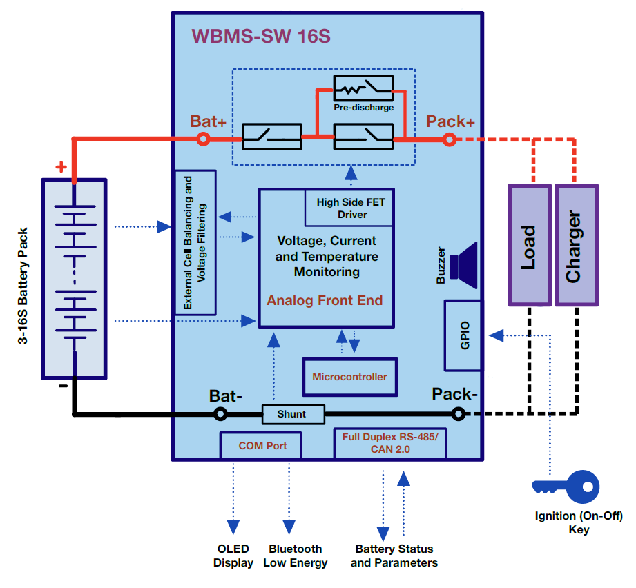
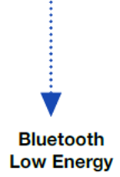


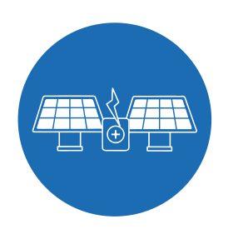

Application Diagram
ISO CAN2.0B

Slide 3
Salient Features
Scalable up to 16 cells & 48-60V battery packs
AIS-156 PH-II Compliant
Buzzer output and LED Indication for Thermal Runaway, Open Wire Fault and MOSFET Failure
Multiple communication options: Isolated CAN2.0 and BLE
Onboard: uSD Card and EEPROM
High side N-MOSFET control provides safe and uninterrupted ground connection to external subsystems.
Predischarge control for preventing inrush currents to capacitive loads. Prevents MOSFET failures and increases cell life
Short Circuit and Overcurrent in discharge latches ensure automatic locking of discharge path after repeated short circuit and overcurrent faults
High cell balancing current up to 400mA minimizes cell to cell voltage and SOC variations and optimal charging of battery pack
Individual Cell over and under voltage and temperature protection
Pack level over current and short circuit protection
Deep Discharge Prevention (Auto BMS Shutdown) when cell voltage is critically low
Proprietary CAN based field servicing tools for data monitoring, logging and firmware update

Slide 4
Specifications |  |  |  | Remarks
Number of Cells |  | Min: 3 Max: 16
Cell Voltage Sensing Range |  | 1.6 - 4.5V
Peak Battery Terminal Voltage |  | 68 V (16S)
Sensing Accuracy |  | Cell Voltage: ±3mV Current: ±1%
Dimension |  | 156 mm X 94 mm X 21 mm (L X B X H)
Rated Nominal Continuous Current Rating | Charging and Discharging Current | Up to 60A and 80A. Needs thermal connection to metal battery pack casing for PDU heat dissipation to maintain continuous current rating. Continuous current rating to be derated to ~65% of the rated value if no thermal connection is present. | Up to 60A/80A Needs thermal connection to metal battery pack casing for PDU heat dissipation to maintain continuous current rating. Continuous current rating to be derated to ~65% of the rated value if no thermal connection is present. | Needs thermal connection to metal battery pack casing. Derating
Cell Balancing | Balancing Current per Cell | Up to ~400mA | High balancing current with thermal connection to onboard heat sink for heat dissipation | High balancing current with thermal connection to onboard heat sink for heat dissipation
Pre-discharge control | Nominal Capacitive load | 3-6mF in 0.5 seconds
BMS Self Current Consumption | Active Mode, Shutdown Mode | Active Mode: ~13mA Shutdown Mode: ~0.15mA
Temperature Sensing | Onboard | One channel for onboard MOSFET temperature
 | External | Six external channels for cell temperature
 | Range and Accuracy | Range: -10℃ to 120℃ Accuracy ±1℃,
Onboard Data Storage | uSD Card or EEPROM | uSD Card: every 1 second, logged over last 60 days EEPROM: every 90 seconds, logged over last 30 days
Over Voltage Protection | Threshold, Protection Trigger Delay | Configurable |  | Configurable, based on target fully charged voltage
 | Fault Response | Charge MOSFET: OFF, Discharge MOSFET: ON
 | Fault Release | Through Hysteresis, Automatic
Under Voltage Protection | Threshold, Protection Trigger Delay | Configurable |  | Configurable, based on target fully charged voltage
 | Fault Response | Discharge MOSFET: OFF, Charge MOSFET: ON
 | Fault Release | Configurable Hysteresis |  | No load removal required. Charging current is allowed.
Over Current in Discharge Protection Level-1 | Threshold, Protection Trigger Delay | Configurable to allow up to 160A/200A discharge for up to 60 seconds |  | Configurable
 | Fault Response | Discharge MOSFET: OFF, Charge MOSFET: ON
 | Fault Release | Auto recovery after no discharge current for 90 secs
Over Current in Discharge Protection Level-2 | Threshold, Protection Trigger Delay | Configurable to instantaneously cut off at 160A/200A discharge current in 100 mSec
 | Fault Response | Discharge MOSFET: OFF, Charge MOSFET: ON
 | Fault Release | Auto recovery after no discharge current for 90 secs
Note: Specifications are indicative only. Final specifications and behaviour including continuous discharge/charge current, balancing current, protection thresholds, etc. may vary depending upon BMS version, BMS mounting scheme, PDU heat dissipation, programmed parameters and application logic.

Slide 5
Specifications |  |  | Remarks
Over Current in Discharge Latch Protection | Threshold | 5 consecutive over discharge current faults
 | Fault Response | Discharge MOSFET: OFF, Charge MOSFET: ON
 | Fault Release | Load Removal or Auto release
Over Current in Charge Protection Level-1 | Threshold, Protection Trigger Delay | Configurable to allow up to 60A/120A charge current for up to 60 seconds | Configurable
 | Fault Response | Discharge MOSFET: ON, Charge MOSFET: OFF
 | Fault Release | Auto recovery after no charge current for 90 secs
Over Current in Charge Protection Level-2 | Threshold, Protection Trigger Delay | Configurable to instantaneously cut off at 64A/128A charge current in 100 mSec
 | Fault Response | Charge MOSFET: OFF, Discharge MOSFET: ON
 | Fault Release | Auto recovery after no charge current for 90 secs
Short Circuit in Discharge Protection | Protection Trigger Delay | ～30 uSec
 | Fault Response | Discharge MOSFET: OFF, Charge MOSFET: OFF
 | Fault Release | Auto recovery after 5 seconds
Short Circuit in Discharge Latch Protection | Threshold | 2 consecutive short circuit faults
 | Fault Response | Discharge MOSFET: OFF, Charge MOSFET: OFF
 | Fault Release | Load Removal
Over Temperature in Discharge Protection | Threshold, Protection Trigger Delay | Configurable | Configurable
 | Fault Response | Discharge MOSFET: OFF, Charge MOSFET: ON
 | Fault Release | Auto recovery below configurable temperature
Under Temperature in Discharge Protection | Threshold, Protection Trigger Delay | Configurable | Configurable
 | Fault Response | Discharge MOSFET: OFF, Charge MOSFET: ON
 | Fault Release | Auto recovery above configurable temperature
Over Temperature in Charge Protection | Threshold, Protection Trigger Delay | Configurable | Configurable
 | Fault Response | Charge MOSFET: OFF, Discharge MOSFET: ON
 | Fault Release | Auto recovery below configurable temperature
Under Temperature in Charge Protection | Threshold, Protection Trigger Delay | Configurable | Configurable
 | Fault Response | Charge MOSFET: OFF, Discharge MOSFET: ON
 | Fault Release | Auto recovery above configurable temperature
Buzzer Output | Alert on Permanent Failure | Thermal Runaway, MOSFET Failure, Cell Open Wire, Short Circuit Latch, Over Current in Discharge Latch, Insulation Failure

Slide 6
Product Naming Convention WBMS-SW-16S-AAA-BBBB-CCCC-VD | WBMS-SW-Mini-AB-16S-45A-BBB-CCCC-HVD.0
A Continuous Current | = 60 (WBMS-SW-16S-60A-) | Continuous Discharge Current = 60A
 | = 80 (WBMS-SW-16S-80A-) | Continuous Discharge Current = 80A
BBBB CAN Communication Hardware Option | = NISO (WBMS-SW-16S-AAA-NISO-) | Non Isolated CAN
 | = ISO (WBMS-SW-16S-AAA-ISO-) | Isolated CAN
CCCC Onboard Data Storage Option | = MSDH (WBMS-SW-16S-AAA-BBBB-MSDH) | uSD Card Holder only
 | = MSDHC (WBMS-SW-16S-AAA-BBBB-MSDHC) | uSD Card Holder + uSD Card
 | = EPRM (WBMS-SW-16S-AAA-BBBB-EPRM) | EEPROM
D Hardware Version | = null (WBMS-SW-16S-AAA-BBBB-CCCC) | Initial release with multiple daughter boards
 | = 2.0 (WBMS-SW-16S-AAA-BBBB-CCCC-V2.0) | Latest release two board architecture with onboard buzzer

Slide 7
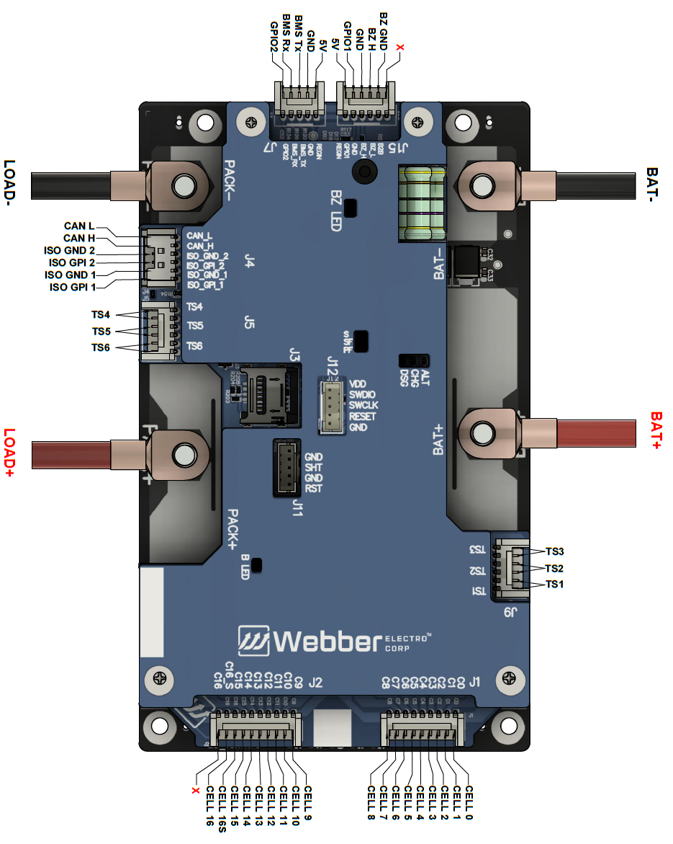
Pin Diagram

Slide 8
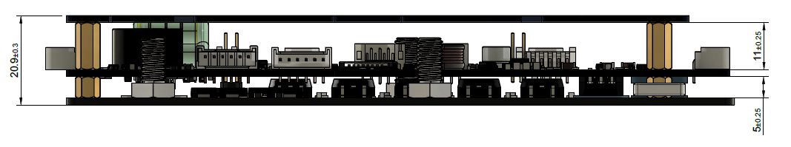
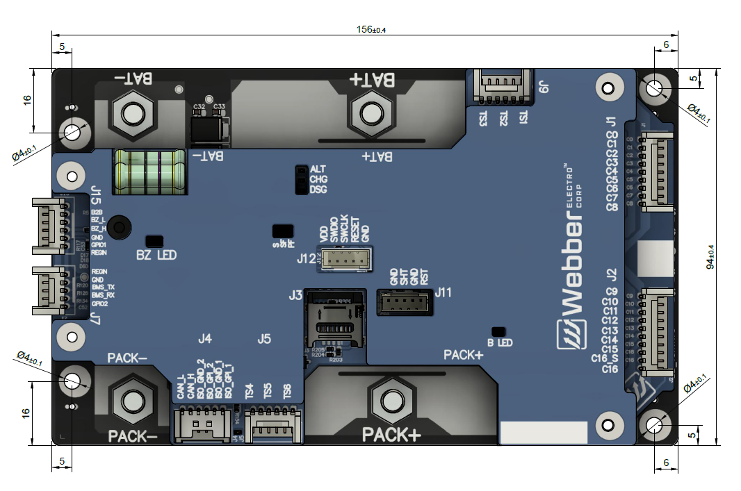
Mechanical Dimensions
All dimensions in mm

